Slide 1




Breakfast
Service
2024-2025
Provided by the LAUSD Food Services Division

Slide 2
To provide an understanding of the School Breakfast Program and its processes.
The following topics will be covered:
  Program Rules.
  Breakfast Meal Count Form.
  Identifying a Reimbursable Meals.
Objectives
Notes:
TELL: The objective is to understand the BIC program and it’s processes . We will go over the meal service, including what a reimbursable meal is and the required classroom signage. We will identify how to enter student and adult meals into the CMS system. Furthermore, we will discuss the benefits of having a good communication system.

Slide 3
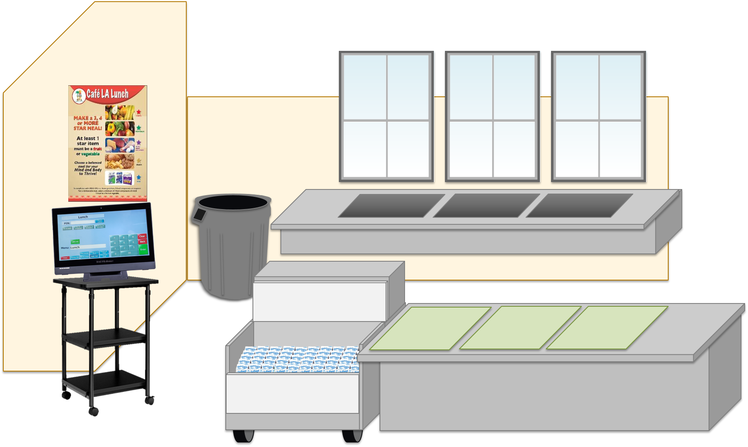
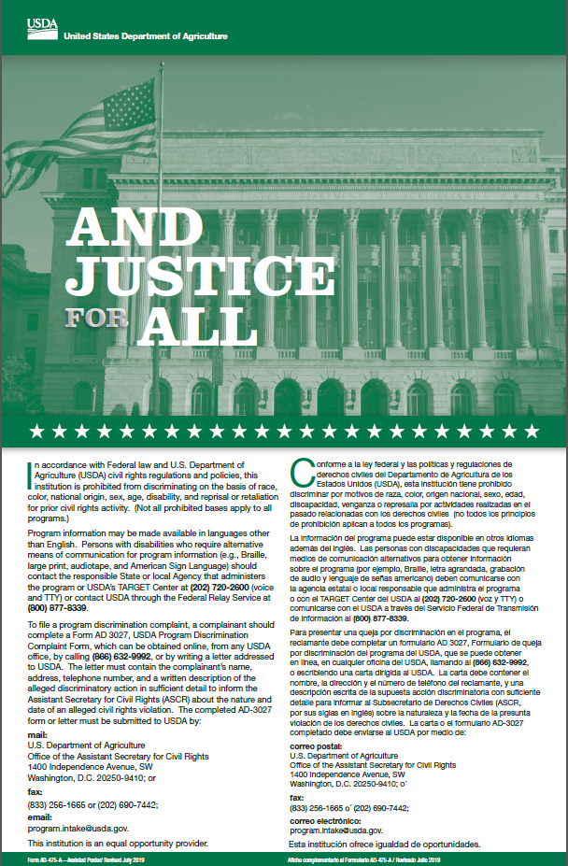

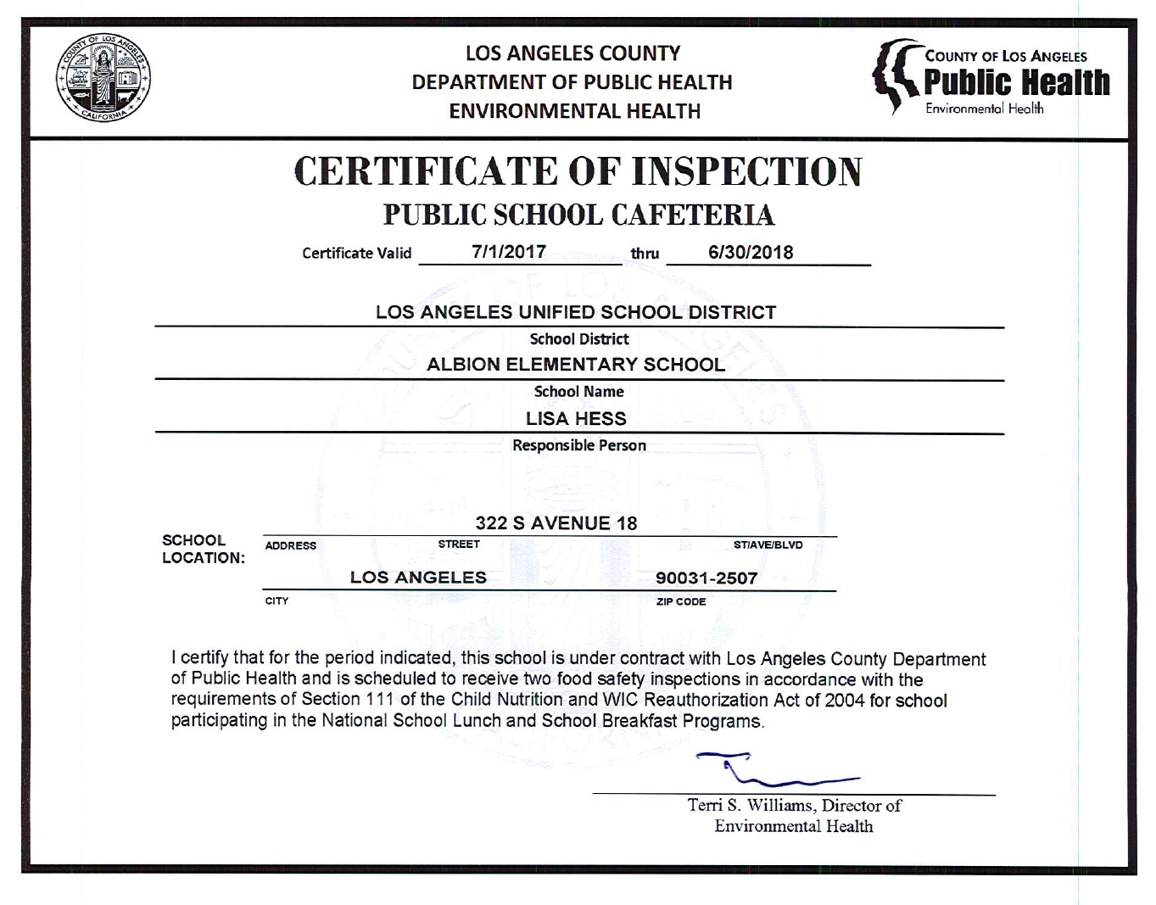
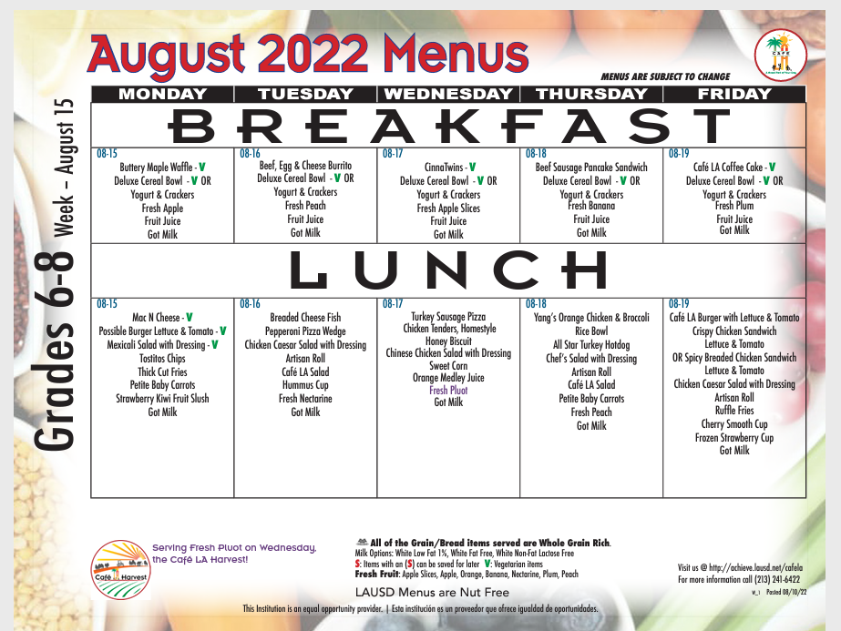


What type of Breakfast service do you use in your cafeteria?
There’s a couple different types of breakfast services.
Notes:
Your setup may differ according to your participation counts, campus, and weekly menu.

Slide 4
Point of
Service
    Cafeteria Service – CMS POS
      Elementary – FSD will utilize the “ No ID Student ” button
      Secondary – Students will input “9”, then press “Enter”
    Mobile Cart Service – Breakfast Meal Count Form or mobile pin pad
    BIC Service – Breakfast Meal Count Form
Notes:
TELL: The Point of Service is the point in the foodservice operation where a determination can accurately be made that a reimbursable meal has been served to an eligible child. This normally occurs at the end of the serving line. This procedure is the same for breakfast and lunch. For breakfast, mark the students off on the roster and for lunch, the POS or rosters. There are no exceptions.

Slide 5





Cafeteria
POS
Setup
Notes:
Your setup may differ according to your participation counts, campus, and weekly menu.

Slide 6


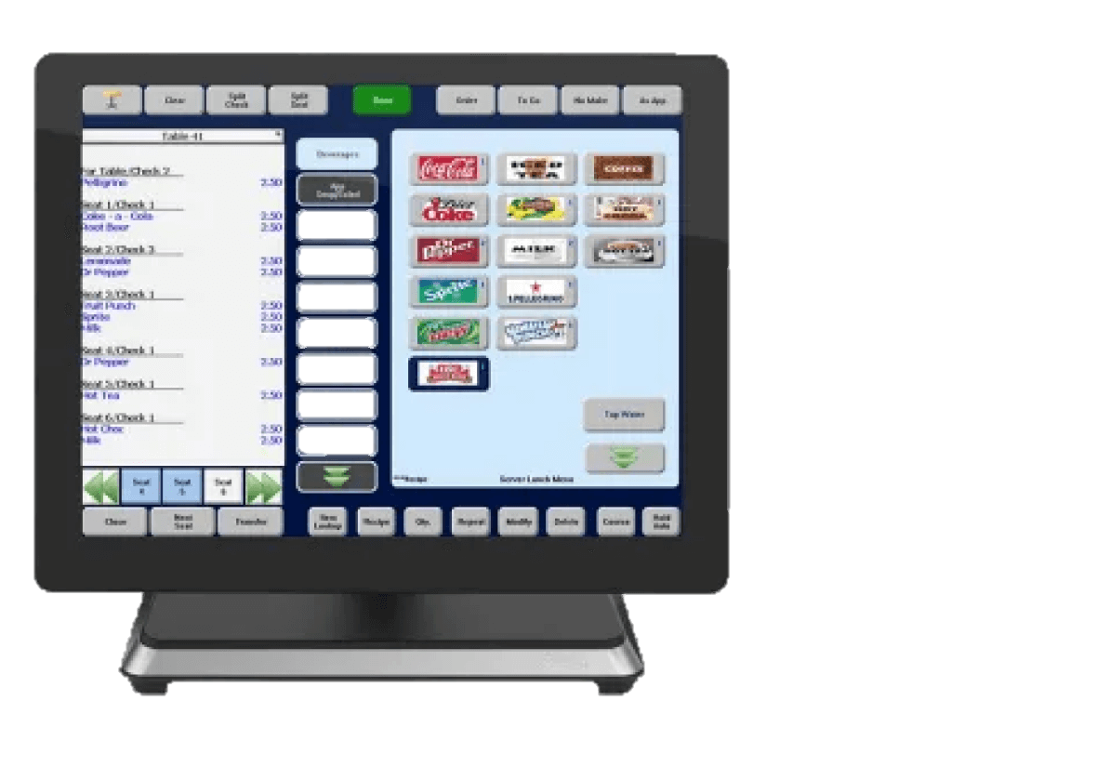
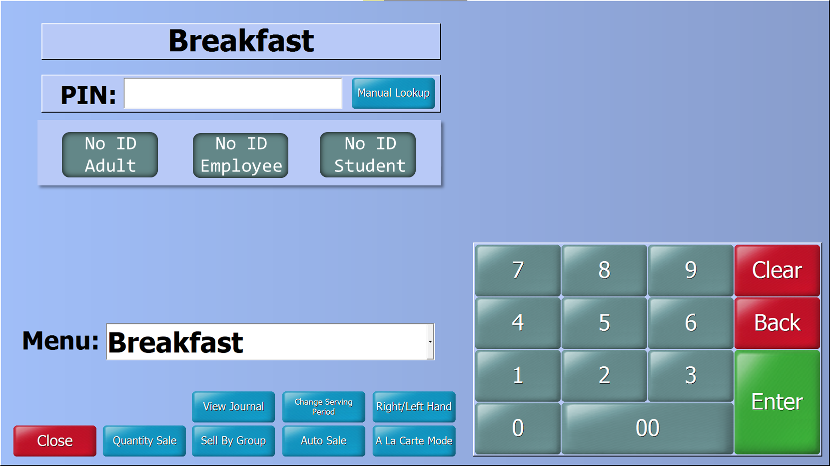



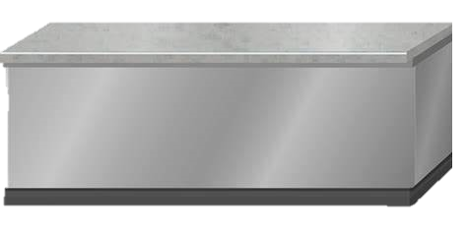
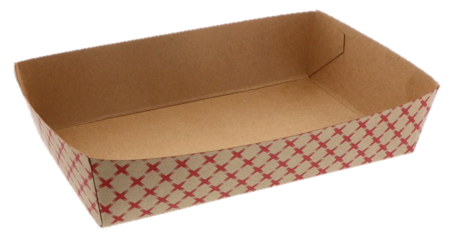
Elementary Cafeteria Service
When a reimbursable meal has been served to an eligible student, FS staff will use the “ No ID Student” button on the POS terminal.

Slide 7


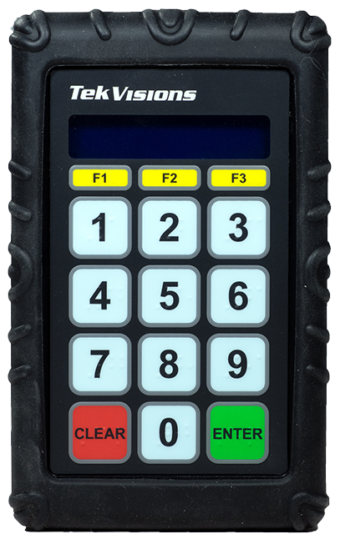





Secondary Cafeteria Service
9
9
9
Secondary sites, students will enter “9” and then press the “Enter” button on the keypad.

Slide 8

How are meals claimed at
elementary sites?
What about secondary sites?
Notes:
Your setup may differ according to your participation counts, campus, and weekly menu.

Slide 9




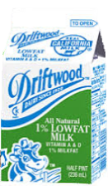




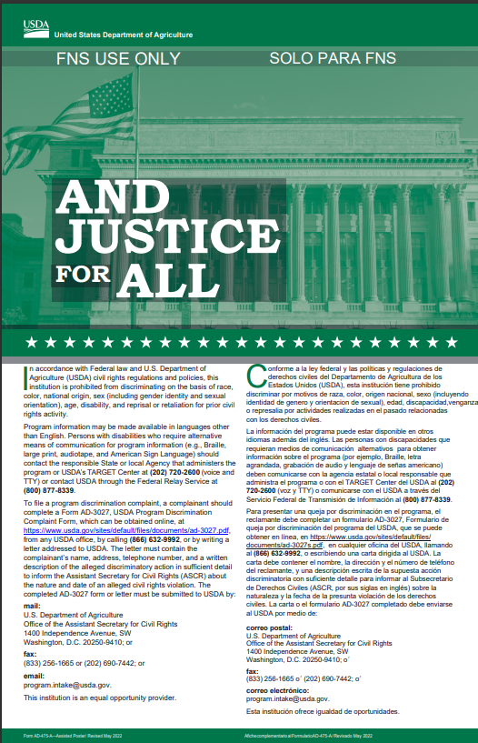
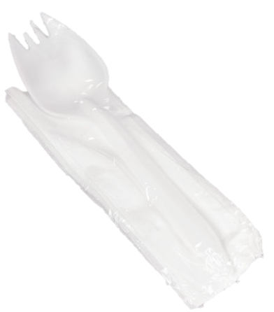
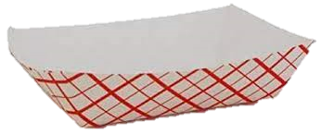
Mobile Cart
Breakfast POS Setup
Students will follow offer vs serve guidelines.
FS staff will utilize the Meal Count form or the Mobile PIN Pad
Notes:
Store less popular items in the same bag to maximize space
Do not crush or squeeze food items into bags; use an additional bag
This model allows for OVS

Slide 10

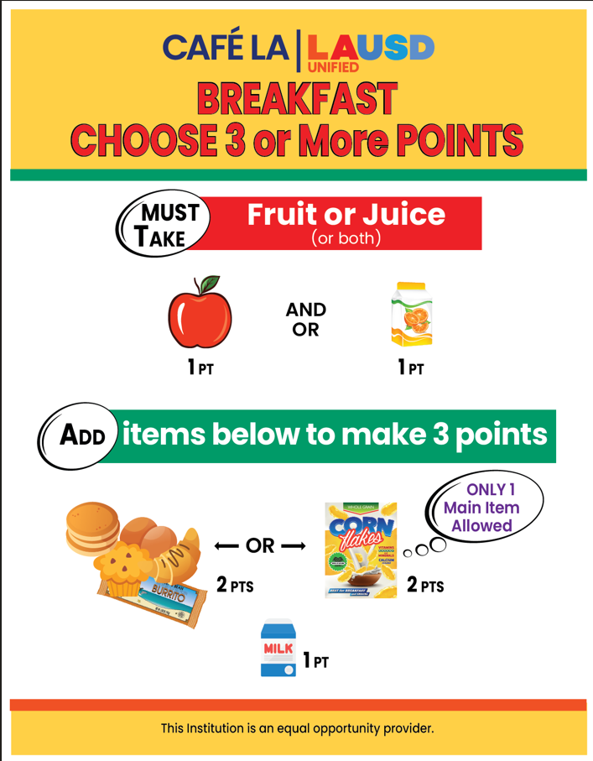
Breakfast
Offer Versus
Service

Slide 11

Offer Versus Serve Breakfast
Offer Versus Serve (OVS) allows students to decline some of the food.
Student must take 3 or more points
One food item must be a fruit
Notes:
TELL:Read slide

Slide 12









A food item can contain one or more food components and is counted as one whole item.
Each food item will count as number of points.
Fruits
Grains
Milk
Fruit Juice
1 Point
Grain + MEAT/MEAT Alternate
2 Points
Breakfast Item
Points
Milk
1 Point
Whole Fruit
1 Point
Grain + Grain
2 Points

Slide 13





Main Item 2 Points At Breakfast
All main items will account for 2 points.
Main items will consist of 2 components. Some with a grain + a meat/meat alternate, others with a grain + grain.
Items with one component such as deluxe cereal and coffee cake would account for a grain + grain.
2 points
(1 point)
(1 point)

Slide 14

Fruit 1 Point at Breakfast
Students must take a fruit during the Breakfast Service period to claim a reimbursable meal. Fruit may be fresh, cooked, dried, canned, frozen or 100% juice. No more than ½ of the fruit offered can be juice (this includes frozen fruit items).
1 point
*Vegetables can be used in lieu of a fruit

Slide 15
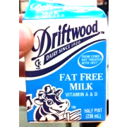
Milk 1 Point at Breakfast
All milk varieties are worth 1 point at breakfast:
Two forms of milk must be offered.
  1% low fat milk
  Fat free milk
Flavored milk cannot be served.
Alternative milk is offered on request.
  Lactose- Free Milk (no form needed)
  Soy Milk (Parental Request to Substitute Soy Milk required)
  Almond milk (Special Diet Form required)

Slide 16








One food item must be a
Fruit Juice or Whole Fruit
Let’s see how they do in
the classroom
Breakfast is now based on a
points system.
Each food item will account for a
certain amount of points
Main food item’s are worth
2 Points
Students must take a total of
3 points
All other food items are worth
1 point
=
Fruit Juice
Deluxe Cereal Bowl
Deluxe Cereal Bowl
Yogurt & Crackers
Milk
Fruit Juice
Whole Fruit
1 point
3 points
2 points
2 points
2 points
1 point
1 point
1 points

Slide 17




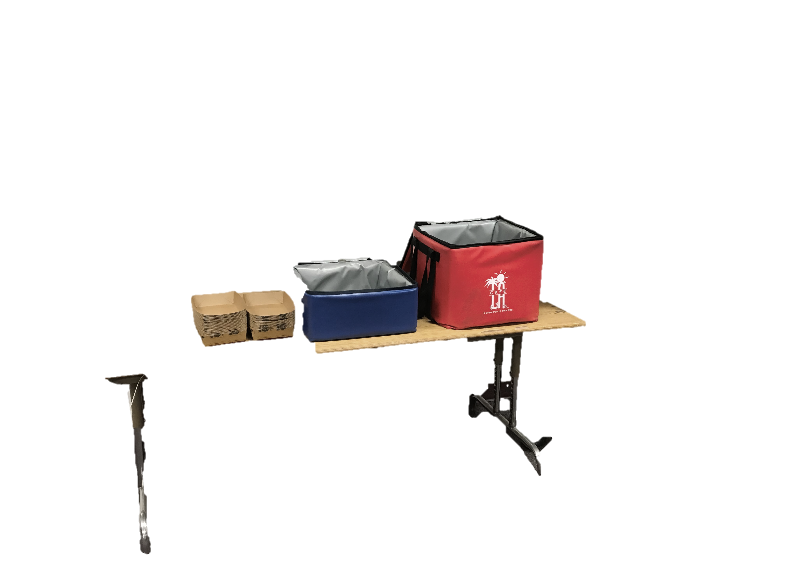
Breakfast
Meal Service
Set-Up
That’s 3 points
Main Item is 2 points
Fruit Juice is 1 point
+
2 points
1 point

Slide 18
Students may take 2 food items as long as it totals to 3 points.
That’s Right!
Lets see another student.

Slide 19



Can students take 4 points?
Breakfast
Meal Service
Set-Up
And it looks like this student
is taking a banana too
Fruit juice is 1 point
Main Item is 2 points
That’s 4 points!
+
+
1 point
2 points
1 point

Slide 20
Students may take more than the recommended
3 points if they like!
That’s perfect!
Lets see another student.

Slide 21
Breakfast
Meal Service
Set-Up
But that’s not a reimbursable meal
Milk is 1 point
That’s 3 points
Please take a fruit juice or whole fruit .
Main Item is 2 points
+
+
2 points
1 point
1 point

Slide 22

A fruit with the meal!
Always remember students must take…
Amazing Job!
Fruit Juice
Whole Fruit
1 point
1 points

Slide 23







For a reimbursable breakfast,
1 food item must be?
FRUIT

Slide 24

Not Too Hungry... Save It For Later
To keep waste down students may save non-perishable items from the menu that day.
Whole Fruit
Cold Cereal
Crackers
Coffee Cake
Pan Dulce

Slide 25
What other combo’s can you come up with? Discuss with the person next to you.
Notes:
Your setup may differ according to your participation counts, campus, and weekly menu.

Slide 26
Breakfast In The Class

Slide 27
Role of The Food Service Staff
Pack BIC insulated bags with food items and paper goods
Provide additional food items to classrooms (as requested).
Provide menus upon request.
Ensure all BIC bags are picked-up and returned.
Clean all bags and remove forms upon their return
Provide FSM with BIC forms

Slide 28
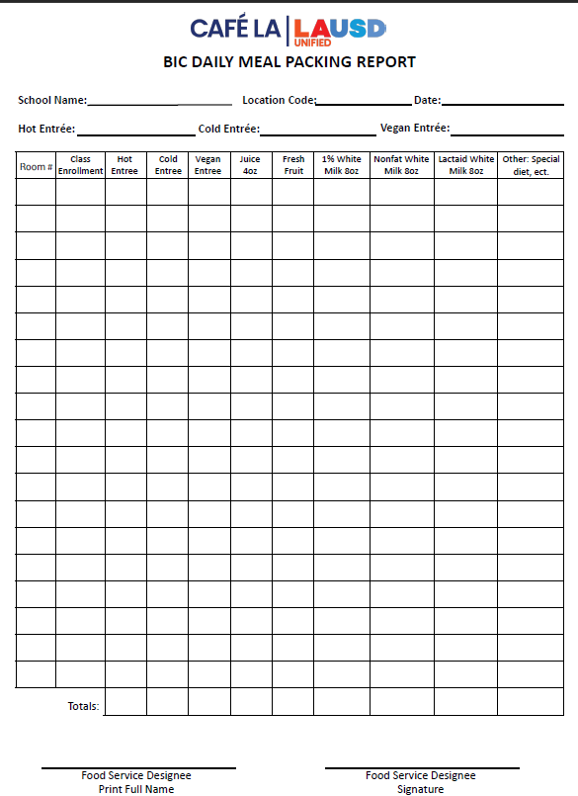
BIC Daily Meal Packing Report
Food Services Staff will complete “BIC Daily Meal Packing Report” to indicate the number of items that are prepared and packed for each classroom. The purpose of the form is to assist in:
  Forecasting production.
  Production quantities.
  Classroom packing amounts.
File according to the Food Service Division Record Retention Guidelines in Folder #1.
Notes:
TELL: Food Services Staff will complete “BIC Daily Meal Packing Guide” to indicate the number of items that are prepared and packed for each classroom. The purpose of the form is to assist in:
Forecasting production
Production quantities
Classroom packing amounts

Slide 29
Update To BIC Daily Meal Packing Report
Beyonce Training Academy
808
8-15-2024
Egg & cheese croissant
Yogurt & crackers
Cinnamon
Granola Cereal
Vegan Entrée – FSM will specify the vegan entrée for the day based on the menu.
Hot Entrée - FSM will specify the hot entrée for the day based on the menu.
Cold Entrée – FSM will specify the cold entrée for the day based on the menu.
Notes:
On Click

Slide 30
How To Fill Out Daily Meal Packing Report
Complete the date, location code and the name of the school.
FSM or designee will provide the room number and class enrollment in the Room and Enrollment column.
Food Services staff will print name and sign to verify the form is completed accurately.
Notes:
TELL: F S Staff will complete the BIC Daily meal packing report. Start by indicating the name of the school, the location code, and the date of service. In the first two columns write the room number and enrollment for each class. When complete food service staff will print their name and sign the form to verify the information is correct.

Slide 31
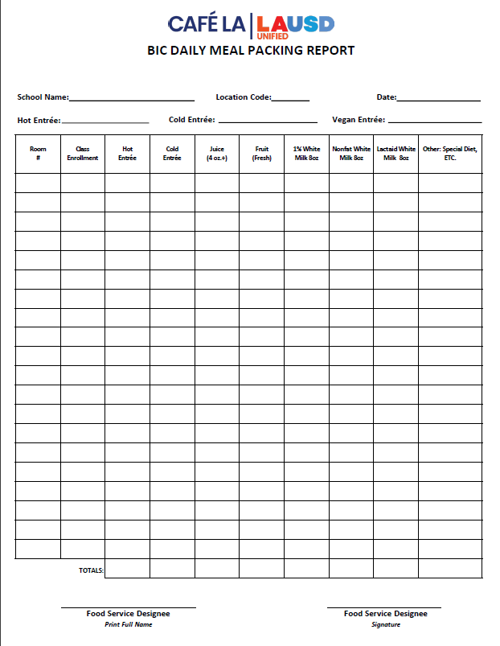
Filling Out BIC Daily Meal Packing Report
20
10
20
10
20
10
1
1
24
6
25
15
20
10
0
0
Write the quantities of each food item packed inside the BIC bags. Quantities are based on student participation, not the classroom enrollment.
44
16
45
25
40
20
1
1
Total each column and indicate the amount packed in the “Totals” section.
Notes:
TELL: Read slide

Slide 32
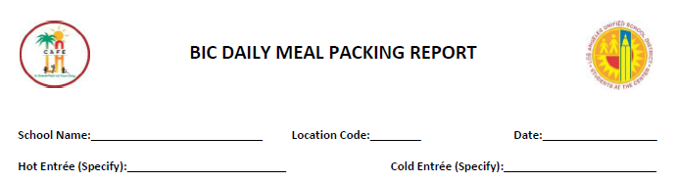
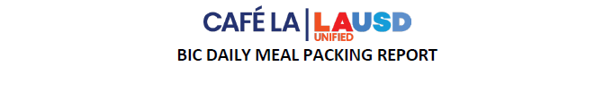
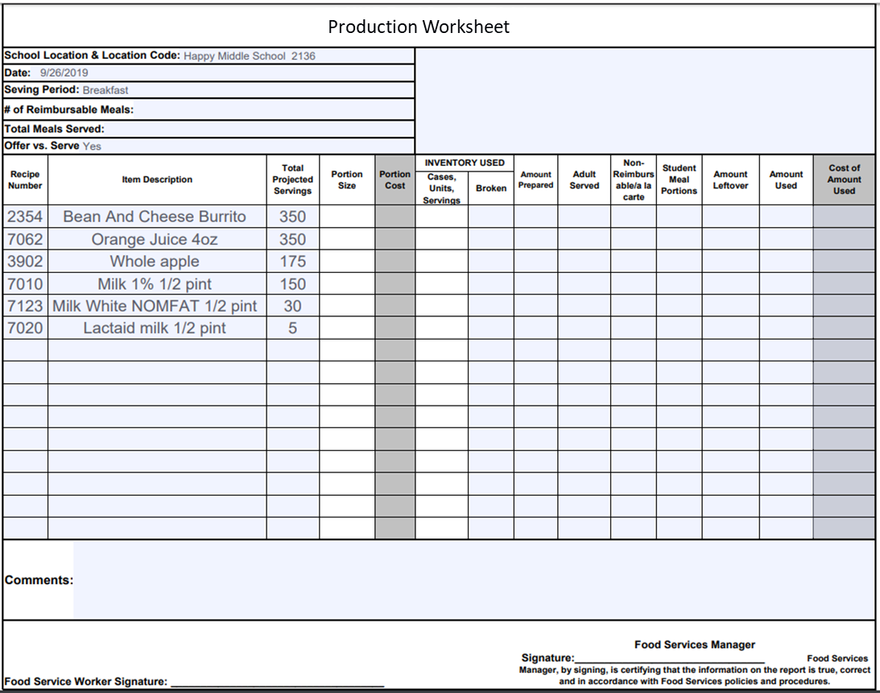
Transferring Totals To Production Worksheet
BIC DAILY MEAL PACKING REPORT
Date: |  | Location Code: |  |  | School Name:
Room # | Enrollment | Entrees Provided | Juice Provided | Fruit Provided | 1% White Milk Provided | Nonfat White Milk Provided | Lactaid White Milk Provided | Other: Special Diet, Soy Milk, ETC
1 | 30 | 25 | 25 | 10 | 8 | 2 | 0 | 0
2 | 27 | 20 | 20 | 10 | 8 | 2 | 2 | 0
3 | 30 | 25 | 25 | 10 | 10 | 2 | 0 | 0
4 | 23 | 22 | 22 | 12 | 8 | 2 | 0 | 0
5 | 45 | 38 | 38 | 10 | 10 | 2 | 1 | 0
6 | 33 | 29 | 29 | 15 | 10 | 2 | 0 | 0
7 | 31 | 29 | 29 | 10 | 10 | 2 | 0 | 0
8 | 30 | 25 | 25 | 15 | 8 | 2 | 0 | 0
9 | 25 | 20 | 20 | 10 | 8 | 2 | 0 | 0
10 | 32 | 29 | 29 | 15 | 10 | 2 | 0 | 0
11 | 15 | 15 | 15 | 15 | 13 | 2 | 0 | 0
12 | 30 | 30 | 30 | 15 | 10 | 2 | 2 | 0
GYM | 45 | 29 | 29 | 15 | 10 | 2 | 0 | 0
Totals: |  | 336 | 336 | 163 | 123 | 26 | 5 | 0
Name: |  |  |  | Signature:
9/26/2019
2136
Happy Middle School
When the “Totals” section is completed, transfer amounts to the “Production Worksheet” in the Amount Prepared column.
The amounts recorded on the “Production Worksheet” should be the same as the “Totals.”
336
336
163
123
26
5
Notes:
TELL: Read slide

Slide 33
When would the daily packing report be filled out?
Notes:
Your setup may differ according to your participation counts, campus, and weekly menu.

Slide 34

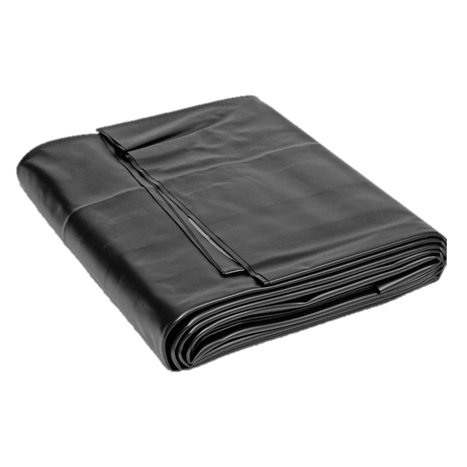

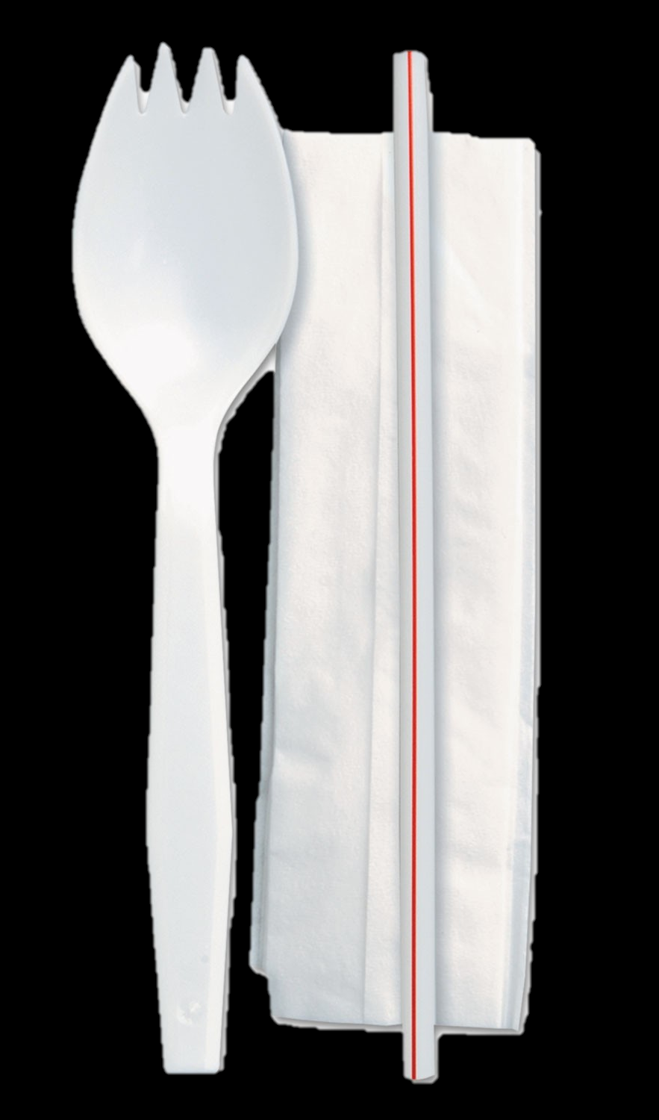


Supplies Needed
The following items will need to be available for breakfast meal service.
Provided items are based on participation, not class enrollment.
Trays ( 3 lbs.).
2 food grade bags per each BIC classroom for share table.
Table cleaning wipes.
Sporkette.
Trash bag liners.

Slide 35
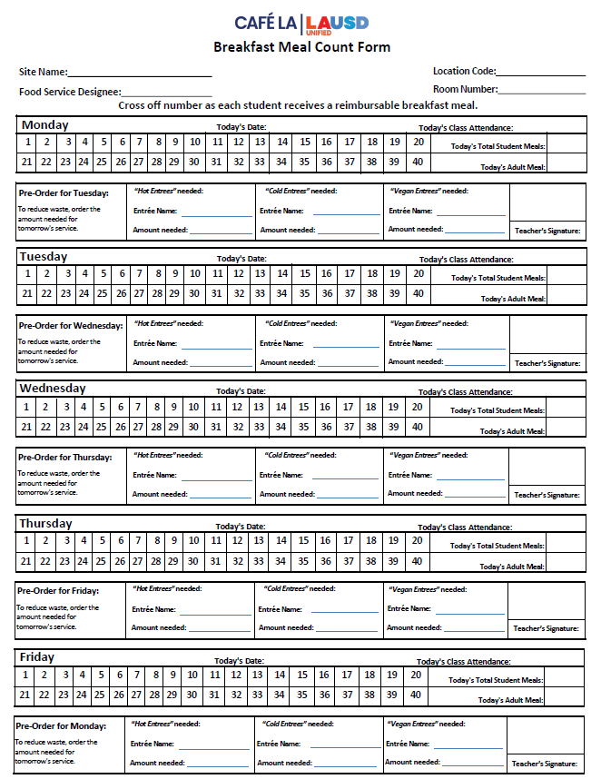
Breakfast Meal Count Form
Introducing the new and improved Breakfast Meal Count form.
Readability has improved to increase in classroom usage.
Same day and forecast areas have been separated.
No more boxes!
A new area has been made for Vegan options.
VEGAN Option

Slide 36
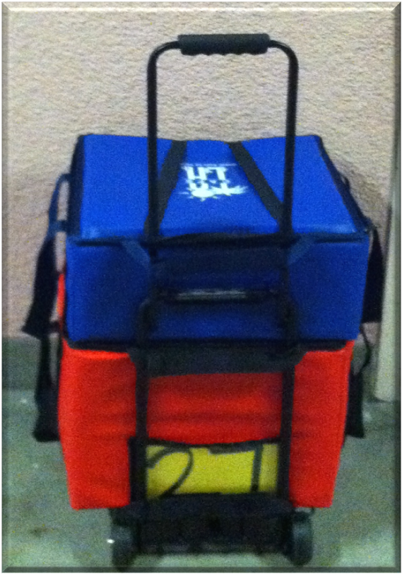
Placement Of Meal Count Form
Food Service Staff will ensure that the “Breakfast Meal Count Form” accompanies the BIC insulated bag.
27

Slide 37
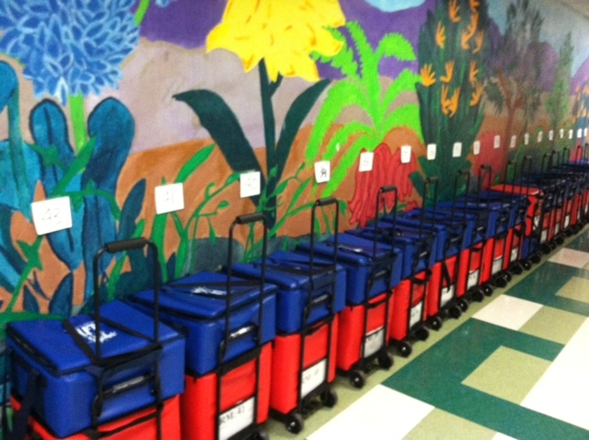
BIC Parking Space
Assign a permanent parking space for the BIC bags.
Create a BIC parking sign for each parking space:
  Identify the room number for each parking space.
  Ensure bags are placed in their proper location with the matching room number.

Slide 38
Do you have a designated parking space in your cafeteria?
Notes:
Your setup may differ according to your participation counts, campus, and weekly menu.

Slide 39
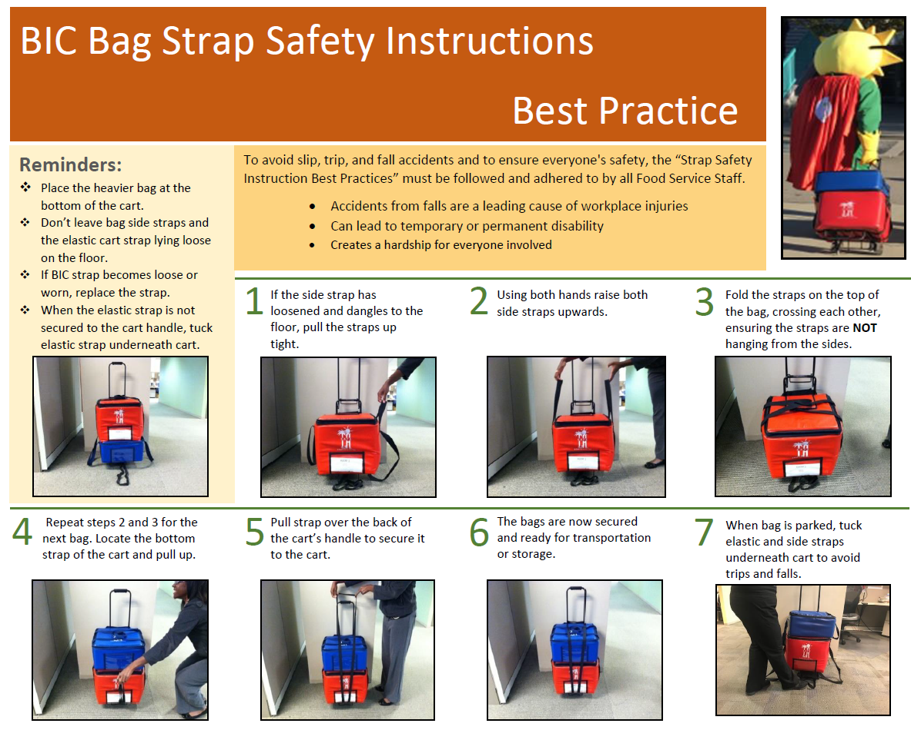
Keeping Students and Café Staff Safe
To avoid slip, trip, and fall accidents, and to ensure everyone's safety. The “Strap Safety Instruction Best Practices” must be followed and adhered to by all Food Service Staff.

Slide 40
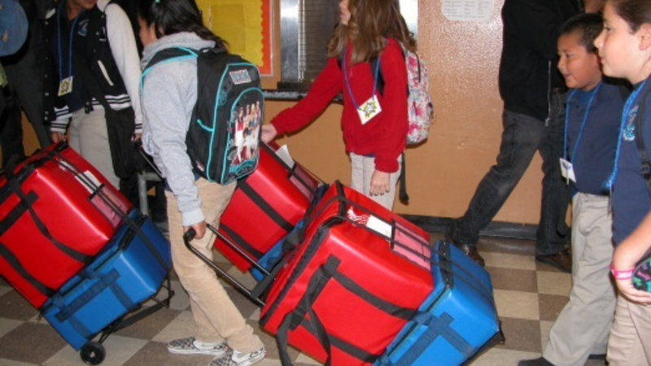
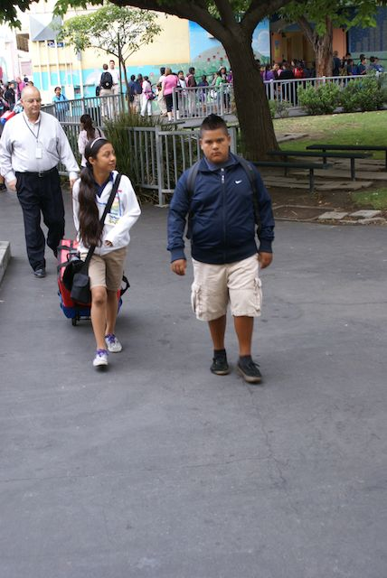
Role of The Delivery Team For BIC
The delivery team has the following responsibilities:
Pick up the insulated bags.
Deliver bags to the correct classroom.
Set up serving area POS inside classroom.
Return insulated bags to the correct parking space.

Slide 41
What type of customer service do you provide when students are picking up the BIC bags?
Notes:
Your setup may differ according to your participation counts, campus, and weekly menu.

Slide 42



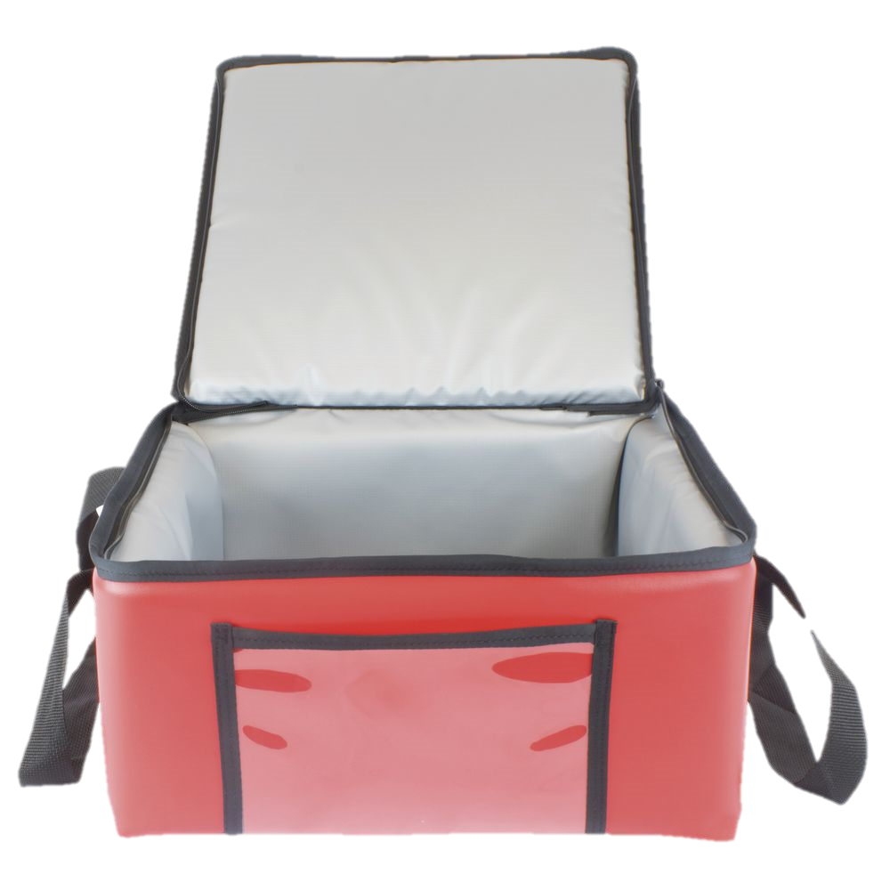




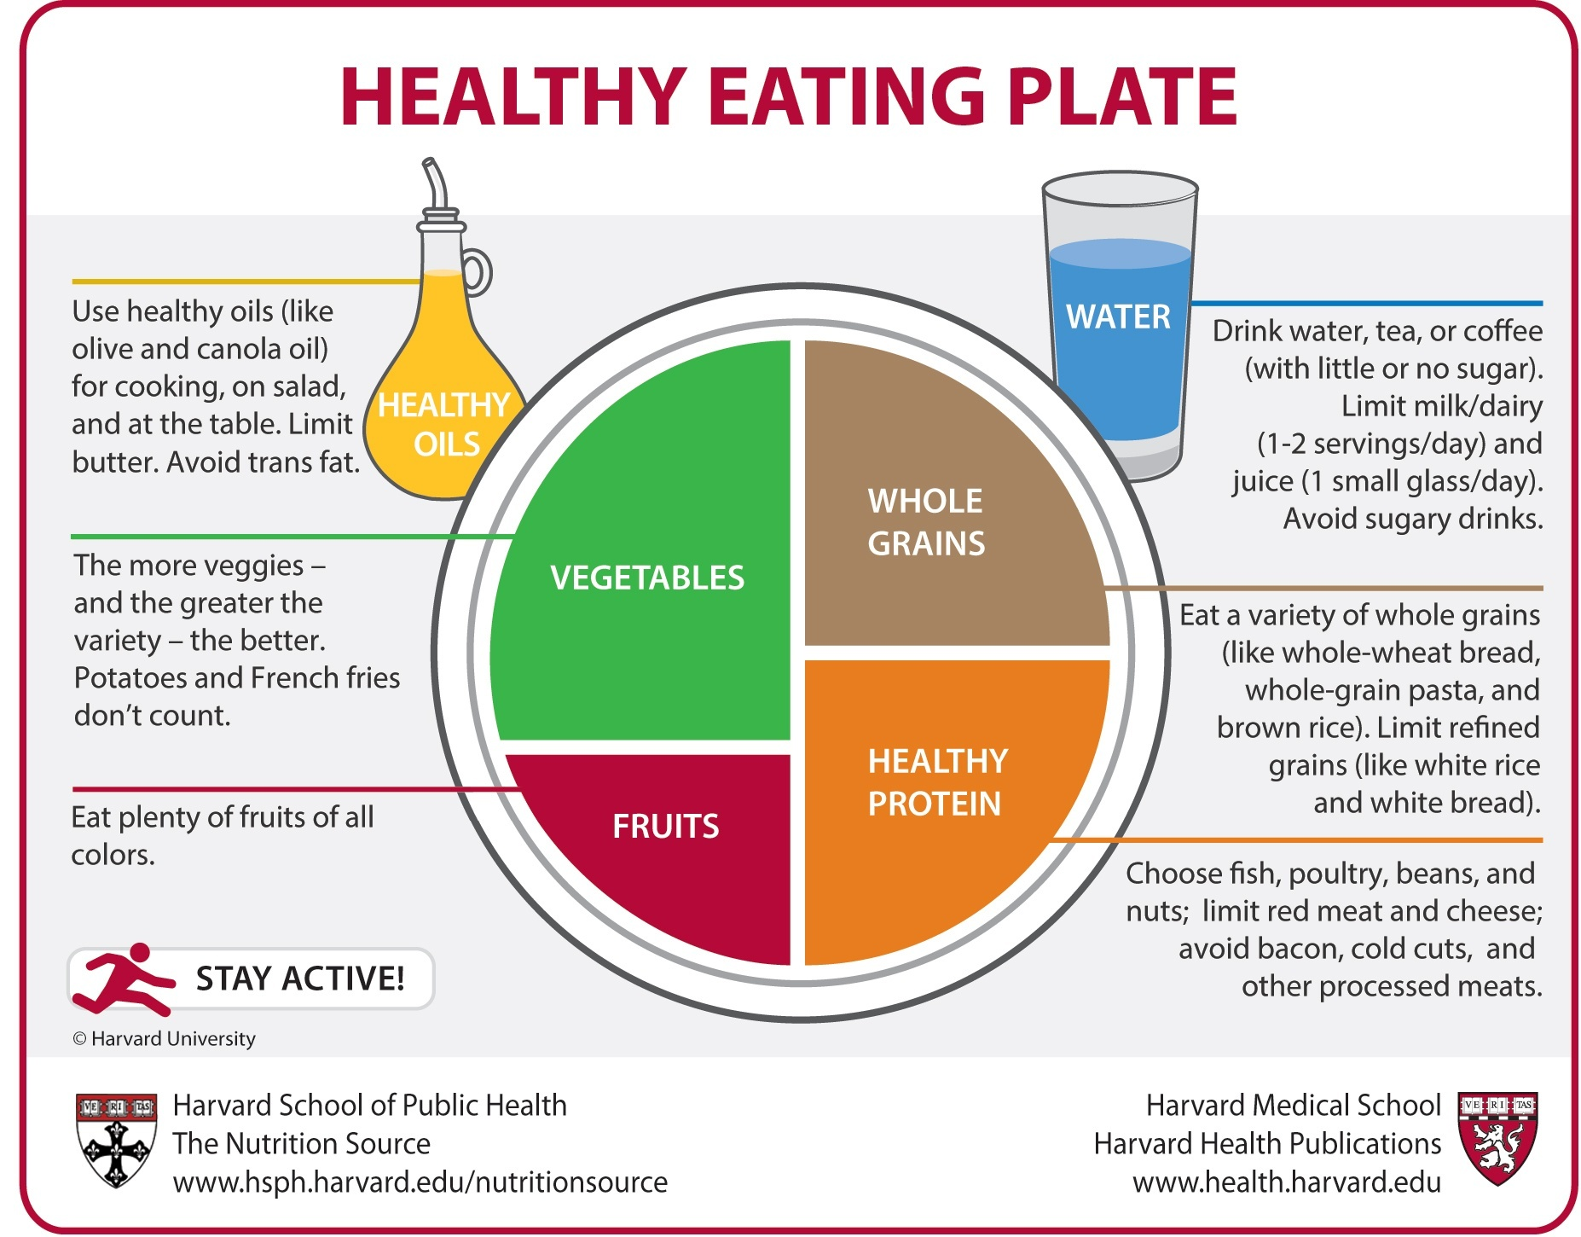
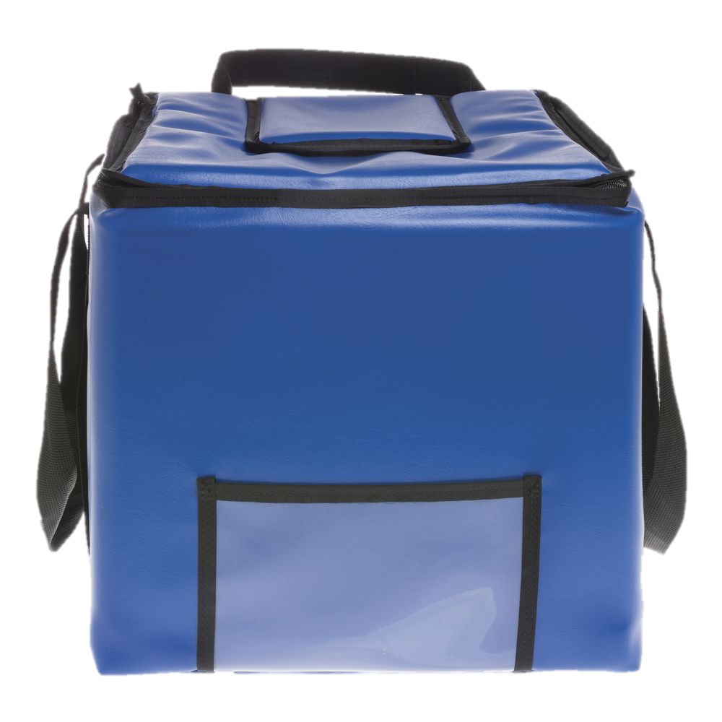
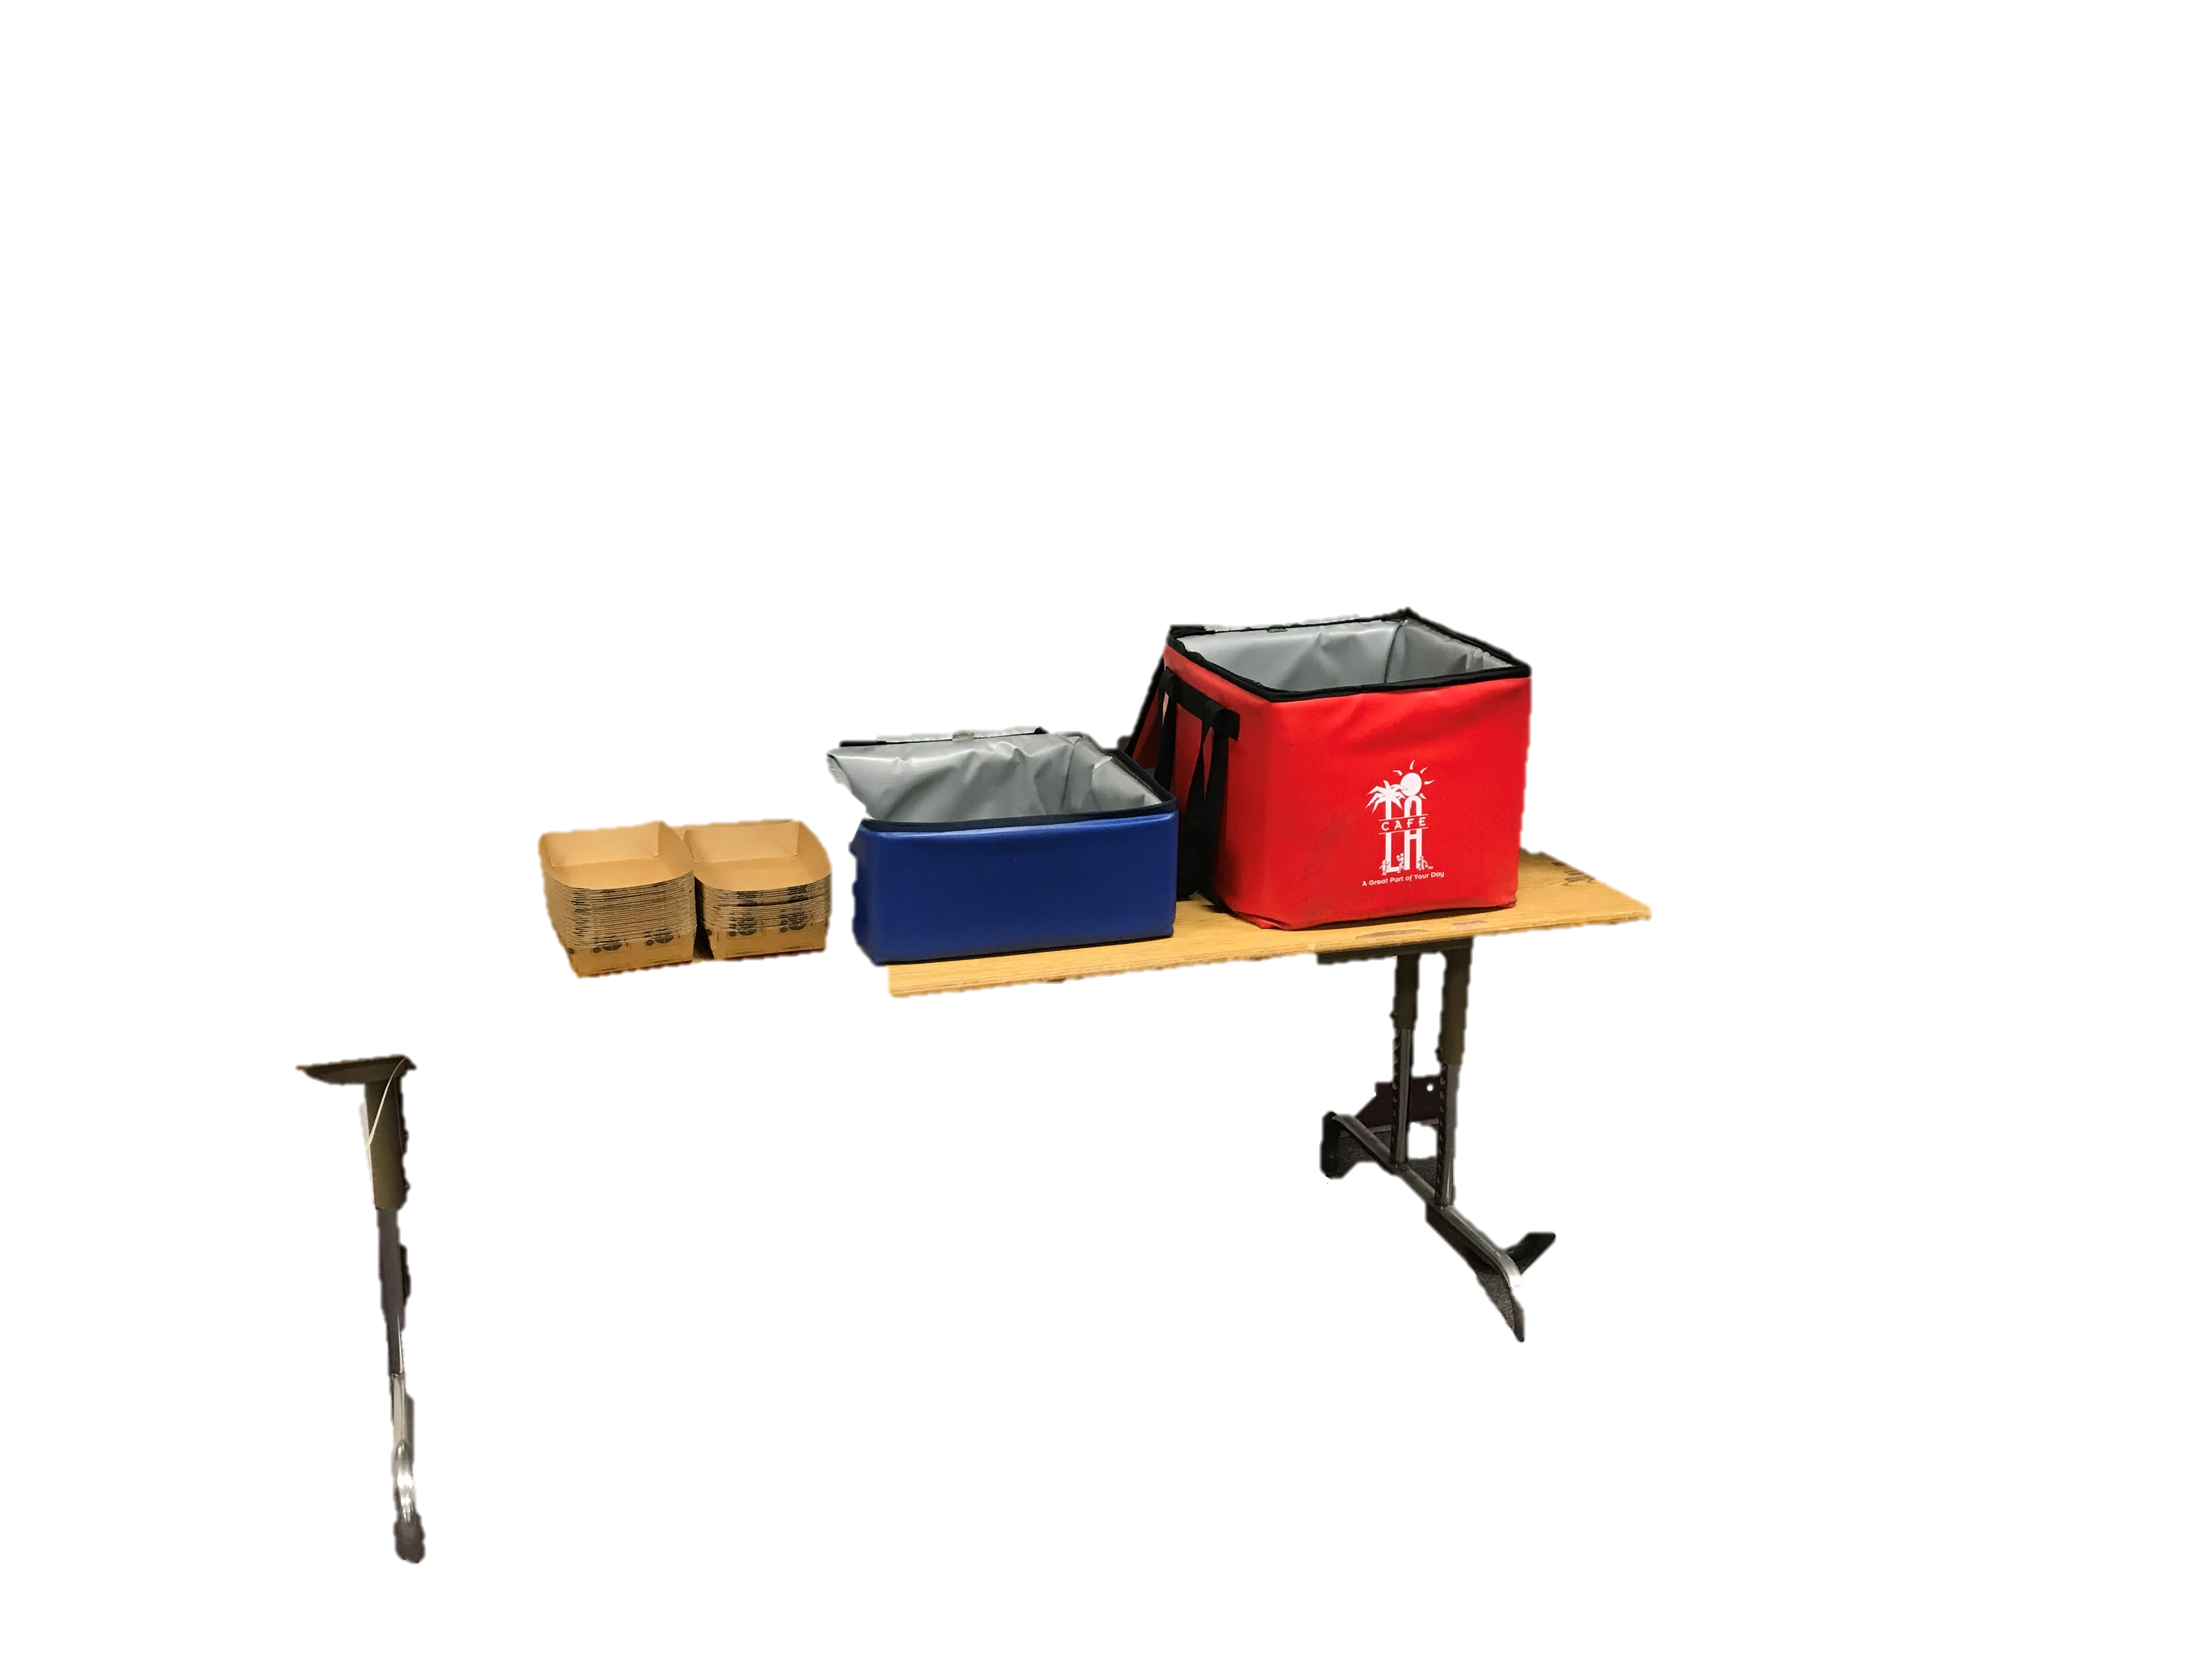

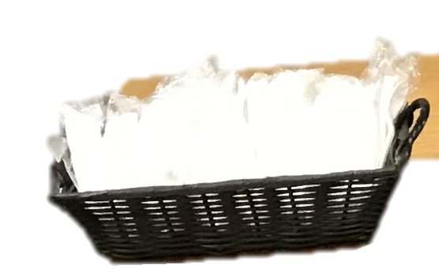
Classroom BIC POS Setup
Breakfast Rules
Why breakfast is so important?
Essential Nourishment
Increased Energy
Better Mood
Improved Concentration
Student must take 3 or more points; one food item must be a fruit.
Meal Count Form
(POS)
Breakfast entree
Milk, Fruit & Juice
Trays/
Sporkettes
(as needed)
Notes:
The Point of Service is the point in the food service operation where a determination can accurately be made that a reimbursable meal has been served to an eligible child. This normally occurs at the end of the serving line. For breakfast, mark the students off on the roster or POS CMS terminal.

Slide 43
After Service
Notes:
TELL:The BiC bags are returned and the leftover amount are recorded on the production worksheet

Slide 44
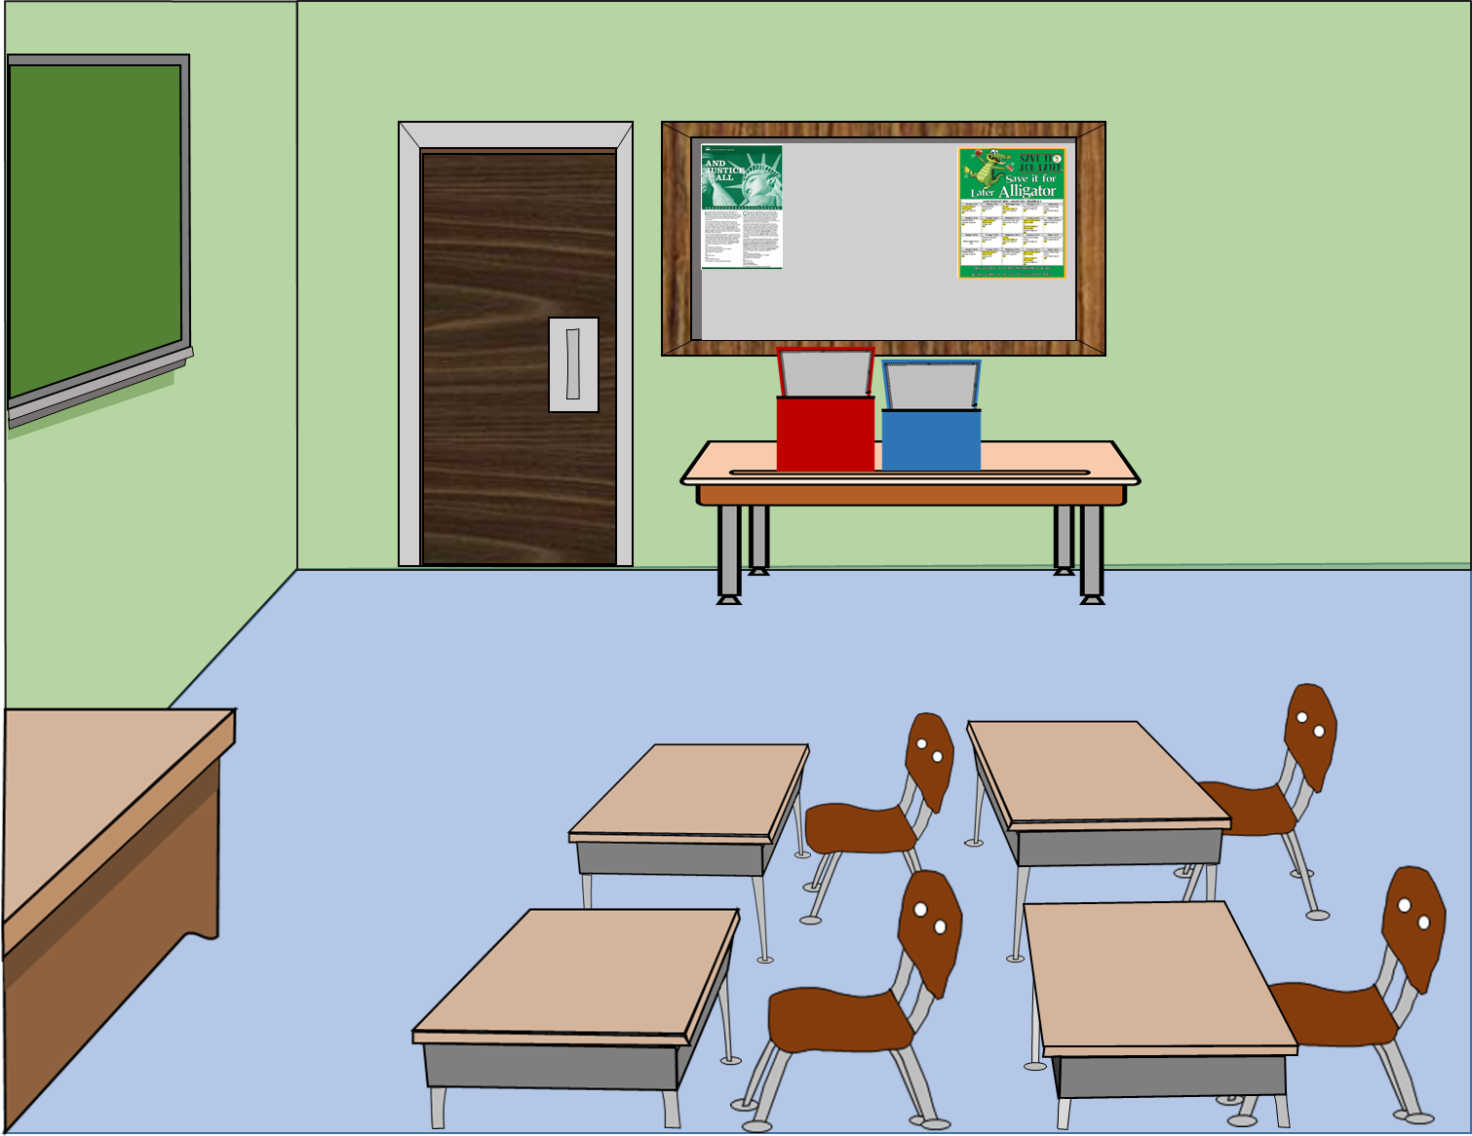

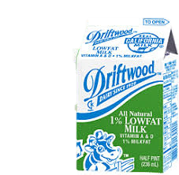


BIC Returned – Unserved Items
  To better understand the BIC procedures, staff needs to become familiar with how to identify the “Unserved Items” returned in BIC Insulated bags.
  Unserved items:
  The unselected food remaining in the BIC insulated bags at the end of meal service.
Notes:
Tell: Read slide

Slide 45
BIC Returned – Share Table Items
  Staff should also understand how to identify the “Share Table Items” returned in BIC Insulated bags.
  Share Table items:
  The food that students have selected and chosen to share with others; students place items in plastic bags on the Share Table.
Notes:
Tell: Read slide

Slide 46
So… if items come back in the plastic bags are those shared items or unserved items?
Notes:
Your setup may differ according to your participation counts, campus, and weekly menu.

Slide 47
Counting Returned Food Items
All food items returned to the cafeteria are to be counted and recorded on the “Production Worksheet” and “Production Record.”
  Count and record the Unserved quantities and the Share Table leftover quantities separately in the Comments section of the “Production Worksheet.”
      Unserved leftovers are foods left in the BIC insulated bag.
      Share table leftovers are the food items inside the plastic bags.
Unserved leftovers- Burrito 20, Juice 23, apples 36, 1% Milk 29, N.F. 6, cereal 1
Comments:
Share table leftovers- Burrito 17, Juice 20, apples 25, 1% Milk 42, N.F. 11, cereal 1
Food Service Manager Signature:
Food Service Worker Signature:
Food Service Manager, by signing, is certifying that the information on the report is true, correct, and in accordance with Food Services policies and procedures.
Notes:
TELL:The BiC bags are returned and the leftover amount are recorded on the production worksheet

Slide 48
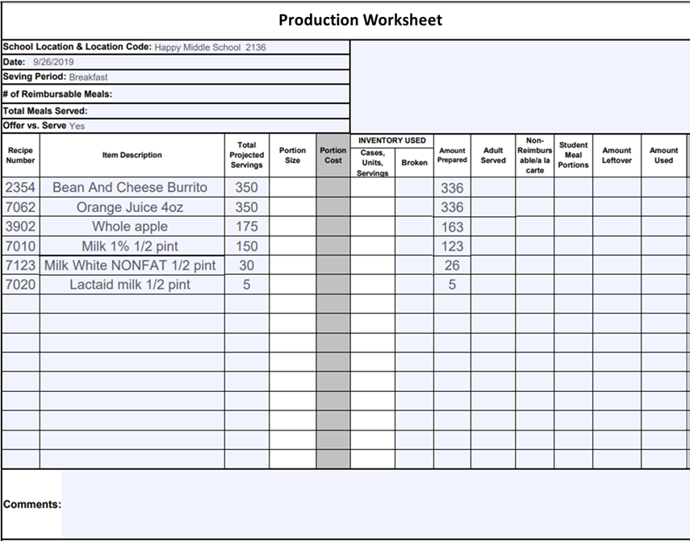

Recording Leftovers Count
Complete the “Production Worksheet” by filling in the Amount Leftover column.
Unserved hot entrees are recorded as leftovers. Do not included hot share table leftovers.
Cold and shelf stable items suitable for reservice may be returned to stock. Record the total of the unserved and share table leftover quantities together.
Unserved hot entrees
Other Leftover Items:
Unserved
Share Table
= Amount Leftover
20
43
61
71
17
0
Unserved leftovers – burritos 20 , juice 23, apple 36, 1%milk 29, N.F 6
Share table leftovers burritos 20, Juice 20,apple 25 , 1% milk 42, N.F. 11
Notes:
TELL:The BiC bags are returned and the leftover amount are recorded on the production worksheet

Slide 49
Items Returned In BIC Bags
  Items that will be returned to stock must be inspected for tampering.
  Store items separately from other inventory.
  Dispose
  of previously heated foods
  Refrigerate
  milk, juice, and yogurt immediately
  Wash
  Fruits that will
  be reserved
  Store
  Shelf stable food according to FIFO rules

Slide 50
How to Return Perishable Items
3
Document the temperatures on the Food Temperature Log.
2
4
Check the temperature of the refrigerated BIC items within three hours of being packed.
If the temperature is below 45° serve items for same-day lunch/supper or next-day breakfast service.
1
5
Immediately place milk, juice, and yogurt that will be reused for service in a refrigeration unit.
If the temperature is above 45° discard the items and adjust the “Production Worksheet.”

Slide 51
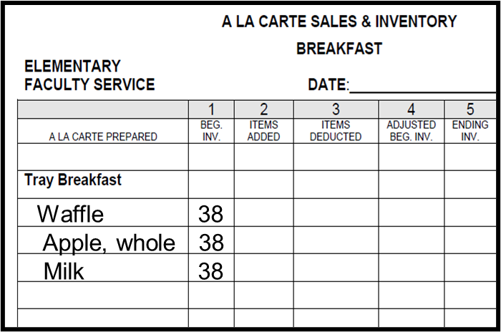
A La Carte Sales and Inventory Form
Beginning inventory is a combination of:
  Faculty Sales
  Employee Meal Allowance
  BIC Adults
Use the “Faculty A la Carte Sales and Inventory” form to record BIC Adult and LAUSD paid staff meals.
Record the total number of breakfast items prepared and sent to the classrooms in Column 1 “Beginning Inventory”.
Cereal 38
Notes:
Tell: The faculty A la Carte Sales and Inventory form will be used to account for meals for BIC adults and LAUSD paid staff. In column “1” place the amount prepared for each item. The beginning inventory is a combination of faculty sales, employee meal allowance, and BIC adults.

Slide 52
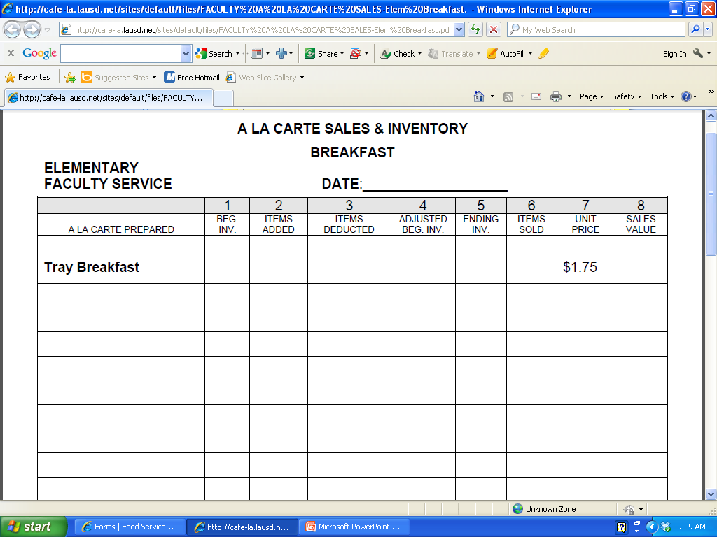
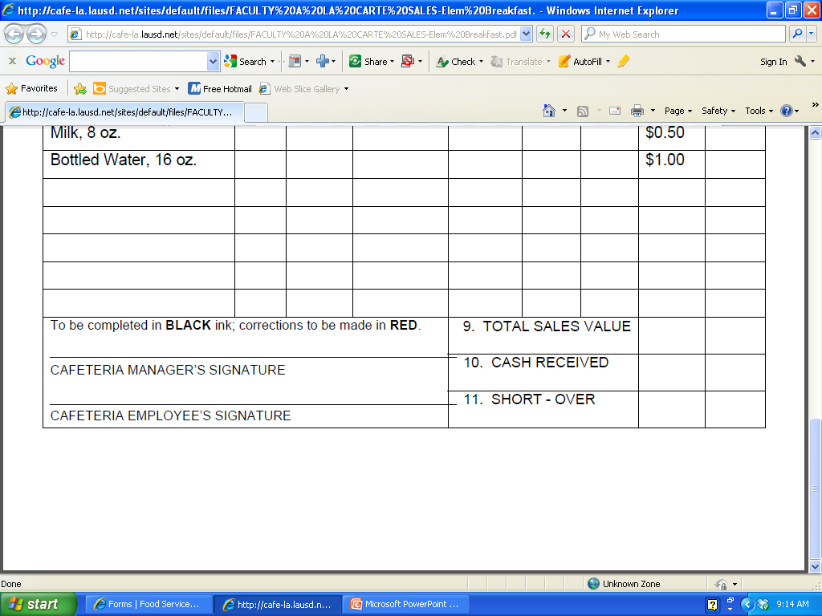
How to Complete A La Carte Sales Form
Subtract the number of adult BIC meals taken in Column 3 “Items Deducted”.
Total adult BIC meals sent to classrooms, plus meals available for the faculty line and FSD staff in Column 1 “Beginning Inventory”.
Waffle 38 30 8
Apple, whole 38 30 8
Milk 38 30 8
Cereal 38 30 8
Document the total number of adult BIC meals used in the “Comment” section.
Enter the new “Adjusted Beginning Inventory” in Column 4 to reflect the number of items available to be sold.
COMMENTS:
30 waffles, milk, cereal & apples were
used for Adult BIC Meals.
Notes:
Tell: In column ”3” place the number of items sent with the BIC bags. Subtract column 3 from 1 and fill in the new beginning inventory in column “4”. In the comment section, document the totals of each item sent with the BIC bags. Document the amount served to BIC adults in the comment section.

Slide 53
Let’s make it happen and make it matter!
Remember breakfast is the most important meal of the day.
Notes:
Your setup may differ according to your participation counts, campus, and weekly menu.

